Slide 1


Engaging Tasks + Productive Struggle = Math Success
Diane J. Briars
Immediate Past President
National Council of Teachers of Mathematics dbriars@nctm.org
nctm.org/briars
2016 MCTM/MinnMATYC Spring Conference
Duluth, MN
April 30, 2016

Slide 2
Agenda
Use three classroom cases to explore two of the Principles to Actions effective teaching practices:
Implement tasks that promote reasoning and problem solving;
Support productive struggle in learning mathematics.

Slide 3

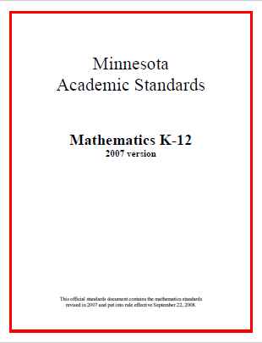
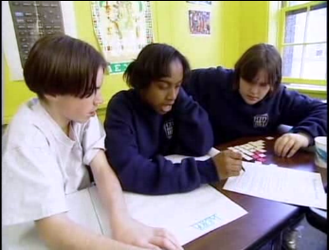
High Quality Standards Are Necessary, but Insufficient, for Effective Teaching and Learning

Slide 4
Key Features of Minnesota Academic Standards
All students should learn important mathematical concepts, skills, and relationships with understanding.
The standards and benchmarks . . . describe a connected body of mathematical knowledge that is acquired through the processes of problem solving, reasoning and proof, communication, connections, and representation.

Slide 5
Key Features of Minnesota Academic Standards
All students should learn important mathematical concepts, skills, and relationships with understanding.
The standards and benchmarks . . . describe a connected body of mathematical knowledge that is acquired through the processes of problem solving, reasoning and proof, communication ,connections, and representation.

Slide 6
Curriculum Standards,
Not Assessment Standards
K1.1. Understand the relationship between quantities and whole numbers up to 31.
3.1.3. Understand meanings and uses of fractions in real-world and mathematical situations
5.2.3. Understand and interpret equations and inequalities involving variables and whole numbers, and use them to represent and solve real-world and mathematical problems.
6.1.2. Understand the concept of ratio and its relationship to fractions and to the multiplication and division of whole numbers.

Slide 7
Curriculum Standards,
Not Assessment Standards
9.2.1 Understand the concept of function, and identify important features of functions and other relations using symbolic and graphical methods where appropriate.

Slide 8
Why Focus on Understanding??
Understanding facilitates initial learning and retention.
Understanding supports appropriate application and transfer.

Slide 9
Key Features of Minnesota Academic Standards
All students should learn important mathematical concepts, skills, and relationships with understanding.
The standards and benchmarks . . . describe a connected body of mathematical knowledge that is acquired through the processes of problem solving, reasoning and proof, communication ,connections, and representation.

Slide 10
Key Features of Minnesota Academic Standards
All students should learn important mathematical concepts, skills, and relationships with understanding.
The standards and benchmarks . . . describe a connected body of mathematical knowledge that is acquired through the processes of problem solving, reasoning and proof, communication, connections, and representation.

Slide 11
Implementing MN Academic Standards requires
Instructional practices that promote students’ development of conceptual understanding and use of problem solving, reasoning, and communication to learn new mathematics.

Slide 12
We Must Focus on Instruction
Student learning of mathematics “depends fundamentally on what happens inside the classroom as teachers and learners interact over the curriculum.”
(Ball & Forzani, 2011, p. 17)
“Teaching has 6 to 10 times as much impact on achievement as all other factors combined ... Just three years of effective teaching accounts on average for an improvement of 35 to 50 percentile points.”
Schmoker (2006, p.9)

Slide 13
Guiding Principles
for School Mathematics
Teaching and Learning
Effective teaching is the non-negotiable core that ensures that all students learn mathematics at high levels.

Slide 14
Guiding Principles
for School Mathematics
Teaching and Learning
Access and Equity
Curriculum
Tools and Technology
Assessment
Professionalism
Essential Elements
of Effective Math
Programs

Slide 15
Principle on Teaching and Learning
An excellent mathematics program requires effective teaching that engages students in meaningful learning through individual and collaborative experiences that promote their ability to make sense of mathematical ideas and reason mathematically.

Slide 16
Effective
Mathematics Teaching Practices
Establish mathematics goals to focus learning.
Implement tasks that promote reasoning and problem solving.
Use and connect mathematical representations.
Facilitate meaningful mathematical discourse.
Pose purposeful questions.
Build procedural fluency from conceptual understanding.
Support productive struggle in learning mathematics.
Elicit and use evidence of student thinking.

Slide 17
Effective
Mathematics Teaching Practices
Establish mathematics goals to focus learning.
Implement tasks that promote reasoning and problem solving.
Use and connect mathematical representations.
Facilitate meaningful mathematical discourse.
Pose purposeful questions.
Build procedural fluency from conceptual understanding.
Support productive struggle in learning mathematics.
Elicit and use evidence of student thinking.

Slide 18
Looking into the Classroom
Select a problem:
Band Concert—Grade 3
Pay It Forward—Grade 8/Algebra 1
Please work the problem as if you were a student.
When done, share your work with people sitting near you.
Discuss:
What mathematics learning could this task support?

Slide 19
Mathematics Learning
Band Concert Task
3.1.2.3. Represent multiplication facts by using a variety of approaches, such as repeated addition, equal-sized groups, arrays, area models, equal jumps on a number line and skip counting.
3.1.2.4. Solve real-world and mathematical problems involving multiplication and division, including both "how many in each group" and "how many groups" division problems.
3.1.2.5. Use strategies and algorithms based on knowledge of place value, equality and properties of addition and multiplication to multiply a two- or three-digit number by a one-digit number. Strategies may include mental strategies, partial products, the standard algorithm, and the commutative, associative, and distributive properties.
Problem solving, reasoning, communication, connections and representation.

Slide 20
Mathematics Learning
Pay It Forward Task
8.2.1.5. Understand that a geometric sequence is a non-linear function that can be expressed in the form f (x)=ab^{x} , where
x = 0, 1, 2, 3,….
8.2.2.5, Represent geometric sequences using equations, tables, graphs and verbal descriptions, and use them to solve problems.
Problem solving, reasoning, communication, connections and representation.

Slide 21
Looking into the Classroom
Read the case for your problem:
  Mr. Harris
  Ms. Culver
Make note of what the teacher did before or during instruction to support his/her students’ engagement/productive struggle with the task.
Talk with a neighbor about the actions and interactions that you identified as supporting productive struggle.

Slide 22
Establish Mathematics Goals
To Focus Learning
Learning Goals should:
Clearly state what it is students are to learn and understand about mathematics as the result of instruction;
Be situated within learning progressions; and
Frame the decisions that teachers make during a lesson.
Formulating clear, explicit learning goals sets the stage for everything else.
(Hiebert, Morris, Berk, & Janssen, 2007, p.57)

Slide 23
Goals to Focus Learning
Mr. Harris’ goal for students’ learning:
Students will extend their understanding of multiplication as equal groups to multiplying one-digit whole numbers by multiples of 10 using strategies based on place value and properties of operations.
Ms. Culver’s goal for students’ learning:
  Students will understand that exponential functions grow by equal factors over equal intervals and that in the general equation y = b^{x}, the exponent (x) tells you how many times to use the base (b) as a factor.

Slide 24
Implement Tasks that Promote
Reasoning and Problem Solving
Mathematical tasks should:
Provide opportunities for students to engage in exploration or encourage students to use procedures in ways that are connected to concepts and understanding;
Build on students’ current understanding; and
Have multiple entry points.

Slide 25
Why Tasks Matter
Tasks form the basis for students’ opportunities to learn what mathematics is and how one does it;
Tasks influence learners by directing their attention to particular aspects of content and by specifying ways to process information;
The level and kind of thinking required by mathematical instructional tasks influences what students learn; and
Differences in the level and kind of thinking of tasks used by different teachers, schools, and districts, is a major source of inequity in students’ opportunities to learn mathematics.

Slide 26
Why Tasks Matter
Tasks form the basis for students’ opportunities to learn what mathematics is and how one does it;
Tasks influence learners by directing their attention to particular aspects of content and by specifying ways to process information;
The level and kind of thinking required by mathematical instructional tasks influences what students learn; and
Differences in the level and kind of thinking of tasks used by different teachers, schools, and districts, is a major source of inequity in students’ opportunities to learn mathematics.

Slide 27
Implement Tasks that Promote
Reasoning and Problem Solving
Mathematical tasks should:
Provide opportunities for students to engage in exploration or encourage students to use procedures in ways that are connected to concepts and understanding;
Build on students’ current understanding; and
Have multiple entry points.

Slide 28

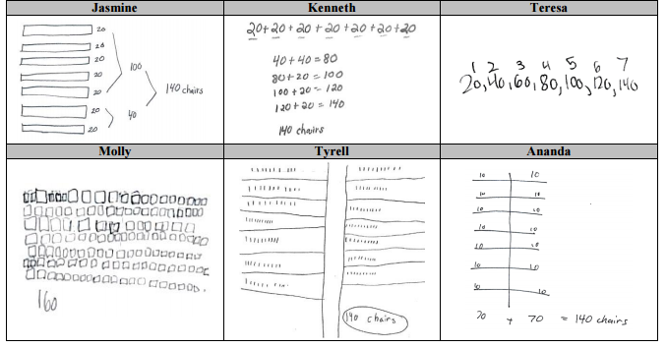
The Band Concert

Slide 29
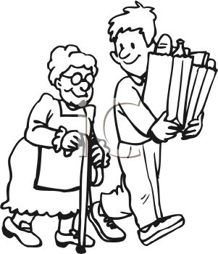
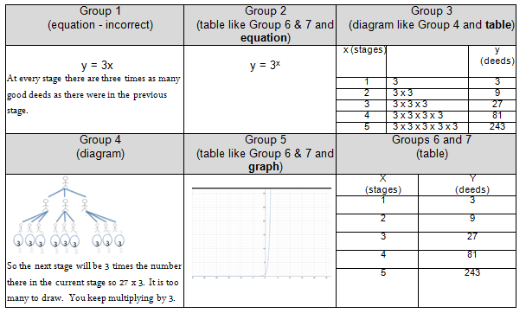
Pay It Forward

Slide 30
Higher-Level Tasks
Doing mathematics
  Band Concert Task
  Pay It Forward Task
Procedures with connections
  Using a 10 x 10 grid, identify the decimal and percent equivalents of 3/5.
  Explain how the graph of y = -3x² + 7 compares to the graph of y = x². Sketch the graph of y = -3x² + 7.
  Smith & Stein, 1998

Slide 31
Lower-Level Tasks
Memorization
  What are the decimal equivalents for the fractions ½ and ¼?
Procedures without connections
  Write the fraction 3/8 as a decimal.
  A rectangular carpet is 12 feet long and 9 feet wide. What is the area of the carpet in square feet?
  Smith & Stein, 1998

Slide 32
Compare Band Concert and
Pay It Forward to:
Find the product
5 x 20 =
6 x 80 =
4 x 70 =
3 x 50 =
9 x 20 =
2 x 60 =
8 x 30 =
Petoskey Population
The population of Petoskey, Michigan, was 6076 in 1990 and was growing at the rate of 3.7% per years. The city planners want to know what the population will be in the year 2025. Write and evaluate an expression to estimate this population.
Notes:
6076 (1.037)^{t}
21,671
Algebra 2
Holt, Rinehart and Winston, 2004
Page 415

Slide 33
Task Analysis Guide
Notes:
Handout- TaskAnalysisGuide
The key feature of this task that makes it DOING MATHEMATICS is the fact that there is no predictable, well-rehearsed pathway available for solving the task. While most of the other characteristics are also applicable, it is this feature that distinguishes it from all other task types.
It is important to note, however, that IF students have already been taught the cross multiplication algorithm and have had opportunities to use it, then this task would be classified as procedures without connections.

Slide 34
Core Instructional Issue
Do all students have the opportunity to engage in mathematical tasks that promote students’ attainment of the mathematical practices on a regular basis?

Slide 35
Support Productive Struggle
in Learning Mathematics
Productive Struggle should:
Be considered essential to learning mathematics with understanding;
Develop students’ capacity to persevere in the face of challenge; and
Help students realize that they are capable of doing well in mathematics with effort.

Slide 36
Support Productive Struggle in Learning Mathematics
The struggle we have in mind comes from solving problems that are within reach and grappling with key mathematical ideas that are comprehendible but not yet well formed
Hiebert et al., 1996
By struggling with important mathematics we mean the opposite of simply being presented information to be memorized or being asked only to practice what has been demonstrated.
Hiebert & Grouws, 2007, pp. 387-388
Notes:
Not talking about giving students impossible problems to.
CLICK ON QUOTE
Students need to be able to figure things out for themselves…it is through this process of figuring things own that they will develop authority and ownership of their own learning.

Slide 37
Looking into the Classroom
What did Mr. Harris/Ms. Culver do before or during instruction to support his/her students’ engagement/productive struggle with the task?

Slide 38
Support Productive Struggle In Learning Mathematics:
Teacher and Student Actions
What are teachers doing?
Anticipating what students might struggle with during a lesson and being prepared to support them productively through the struggle.
Giving students time to struggle with tasks, and asking questions that scaffold students’ thinking without stepping in to do the work for them.
Helping students realize that confusion and errors are a natural part of learning, by facilitating discussions on mistakes, misconceptions, and struggles.
Praising students for their efforts in making sense of mathematical ideas and perseverance in reasoning through problems.
What are students doing?
Struggling at times with mathematics tasks but knowing that breakthroughs often emerge from confusion and struggle.
Asking questions that are related to the sources of their struggles and will help them make progress in understanding and solving tasks.
Persevering in solving problems and realizing that is acceptable to say, “I don’t know how to proceed here,” but it is not acceptable to give up.
Helping one another without telling their classmates what the answer is or how to solve the problem.
Notes:
The table shown in this slides summarizes teacher and student actions that embrace struggle as a natural aspect of learning.
You may want to distribute a copy of the teacher and student actions to facilitate teachers discussion/reflection related to the last slide.
HANDOUT 9-TeacherandStudent Actions-HS-Ziegler

Slide 39
The Band Concert

Slide 40
Pay It Forward

Slide 41
Planning with the Student in Mind
Anticipate solutions, thoughts, and responses that students might develop as they struggle with the problem
Generate questions that could be asked to promote student thinking during the lesson, and consider the kinds of guidance that could be given to students who showed one or another types of misconception in their thinking
Determine how to end the lesson so as to advance students’ understanding
  Stigler & Hiebert, 1997

Slide 42
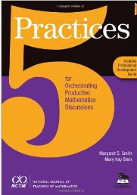
Five Practices for Orchestrating Productive Discussions
Anticipating likely student responses
Monitoring students’ actual responses
Selecting particular students to present their mathematical work during the whole class discussion
Sequencing the student responses
Connecting different students’ responses—to each other and to key mathematical ideas.
Smith & Stein, 2011

Slide 43
Effective
Mathematics Teaching Practices
Establish mathematics goals to focus learning.
Implement tasks that promote reasoning and problem solving.
Use and connect mathematical representations.
Facilitate meaningful mathematical discourse.
Pose purposeful questions.
Build procedural fluency from conceptual understanding.
Support productive struggle in learning mathematics.
Elicit and use evidence of student thinking.

Slide 44

The Case of Jeff Ziegler
High School
Effective Mathematics Teaching Practices
Developed by Margaret Smith and Victoria Bill at the University of Pittsburgh. Video courtesy of Pittsburgh Public Schools and the Institute for Learning.
Notes:
This session focuses on Productive Struggle. It is suggested that teachers have some familiarity with the Effective Teaching Practices prior to engaging in this session.
There are two sessions available that provide an overview of the Teaching and Learning Principle, with some discussion of each of the effective teaching practices http://www.nctm.org/PrinciplestoActions/ .-- The Candy Jar (middle school content) or the Pay It Forward (high school content).

Slide 45
The S Pattern Task¹
1
2
3
4
5
    1. What patterns do you notice in the set of figures?
    2. How many square tiles are in figure 7? Write a description that could be used to determine the shape of and total number of square tiles in figure 7. Your description should be clear enough so that another person could read it and use it to think about another figure.
    3. Determine an equation for the total number of squares in any figure. Explain your rule and show how it relates to the visual diagram of the figures.
    4. Find a second way to describe the pattern and write the equation that matches the description. Compare the two equations and show in the visual representation how one equation is equivalent to the other.
    5. If you knew that a figure had 9802 squares tiles in it, how could you determine the figure number? Explain.
    Does the pattern describe a linear relationship between the figure number and the total number of squares? Why or why not?
¹This task was adapted from Visual Mathematics Course II, Lessons 1-10 published by The Math Learning Center, Salem, OR.
Notes:
The video clips featured in this session feature students who are trying to write equations for the total number of squares in any figure and relate the equations they create to the physical arrangement of tiles in the figures (Step 3) .
It is suggested that you engage teachers in solving the task prior to analyzing the video. This will take 45-60 minutes. The lesson guide (8. Calling Plans-LESSON GUIDE) contains suggestions for conducting the lesson and sample solutions that may be helpful to you.
If you don’t have time to engage teachers in the lesson, you should give the teachers several different forms of the function (shown below) and ask them to relate the function to the physical arrangement of tiles in the S-Pattern.
n-= total number of tiles
f= figure number
n= f² + 1
n= (f + 1)(f - 1) + 2
n= (f - 1)² + 2f
n= f(f+1) - (n-1)

Slide 46
The S-Pattern Task
Video Context
School: Langley High School, Pittsburgh Public Schools
Teacher: Mr. Jeffrey Ziegler
Principal: Linda Baehr
Class: 11th-12th Grade Students
At the time the video was filmed, Jeffery Ziegler was a coach at Langley High School in the Pittsburgh Public School District. The students are 11th and 12th grade and struggle with mathematics.
(Jeffrey Ziegler is currently a curriculum supervisor for grades 6-12 mathematics in the Pittsburgh Public School district.)

Slide 47
Mr. Ziegler’s
Mathematics Learning Goals
Students will understand that:
  An equation can be written that describes the relationship between 2 quantities;
  Different but equivalent equations can be written that represent the same situation; and
  The symbolic and pictorial representations can be connected.

Slide 48

The S-Pattern Task
The Context of Video Clips
The lesson begins with Mr. Ziegler engaging students in a brief discussion of the task. They establish the fact that this was a growth pattern that is growing in two dimensions, getting both “taller” and “bigger”. Before they begin their work, Mr. Ziegler tells students:
“Now there are 6 prompts... Kind of the first one, the second one, third one is to kind of get you started but it is on you guys to work with your groups to come up with a way to find the patterns. You don’t necessarily have to word-for-word answer these questions, but they’re there to help you maybe get started.
The clip begins as small groups begin to work on the task and Mr. Ziegler visits Groups 1 and 2.

Slide 49
Lens for Watching the Video Clip 1
As you watch the video, make note of what the teacher does as he interacts with groups 1 and 2.
In particular, identify any of the Effective Mathematics Teaching Practices that you notice Mr. Ziegler using.
Also, record any questions that you have (wonderings)
Notes:
Here are some of the things that teachers might notice:
He did not stand over students - he either sits at their table or kneels on the floor so he can make eye contact with them.
He did not tell students how to solve the task (in the case of group 1) and he did not indicate whether group 2 was correct or incorrect.
He asked questions to elicit student thinking regarding what they had done and what they understand about what they had done.
He pressed group 1 to try to find a way to find the total number of tiles in a figure without counting. He wanted them to focus on the shape of the figure and use the shape to find a more efficient way to count.
Although 1 student in group 2 could describe an equation for the total number of tiles, he pressed the other students in the group to explain it in terms of the picture.
He left both groups with something to think about -- he didn’t hover over them but rather left them to figure out what to do next
Teachers may identify goals, tasks, questions as effective teaching practices that were used. (See Ziegler Analysis notes for details.)
Teachers may not indicate that the Ziegler’s actions provide evidence of productive struggle. You might ask: Did the teacher support productive struggle? You can then proceed to talk about what productive struggle is. (The next slide will help.)

Slide 50
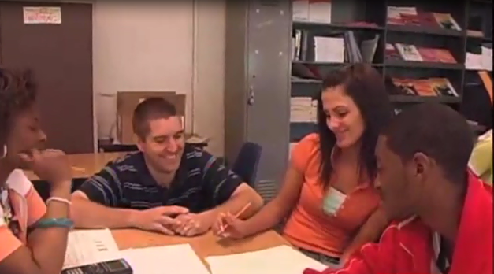
Video Clip 1
http://www.nctm.org/Conferences-and-Professional-Development/Principles-to-Actions-Toolkit/The-Case-of-Jeffrey-Ziegler-and-the-S-Pattern-Task/

Slide 51
Lens for Watching the Video Clip 1
As you watch the video, make note of what the teacher does as he interacts with groups 1 and 2.
In particular, identify any of the Effective Mathematics Teaching Practices that you notice Mr. Ziegler using.
Also, record any questions that you have (wonderings)
Notes:
Here are some of the things that teachers might notice:
He did not stand over students - he either sits at their table or kneels on the floor so he can make eye contact with them.
He did not tell students how to solve the task (in the case of group 1) and he did not indicate whether group 2 was correct or incorrect.
He asked questions to elicit student thinking regarding what they had done and what they understand about what they had done.
He pressed group 1 to try to find a way to find the total number of tiles in a figure without counting. He wanted them to focus on the shape of the figure and use the shape to find a more efficient way to count.
Although 1 student in group 2 could describe an equation for the total number of tiles, he pressed the other students in the group to explain it in terms of the picture.
He left both groups with something to think about -- he didn’t hover over them but rather left them to figure out what to do next
Teachers may identify goals, tasks, questions as effective teaching practices that were used. (See Ziegler Analysis notes for details.)
Teachers may not indicate that the Ziegler’s actions provide evidence of productive struggle. You might ask: Did the teacher support productive struggle? You can then proceed to talk about what productive struggle is. (The next slide will help.)

Slide 52
Effective
Mathematics Teaching Practices
Establish mathematics goals to focus learning.
Implement tasks that promote reasoning and problem solving.
Use and connect mathematical representations.
Facilitate meaningful mathematical discourse.
Pose purposeful questions.
Build procedural fluency from conceptual understanding.
Support productive struggle in learning mathematics.
Elicit and use evidence of student thinking.

Slide 53
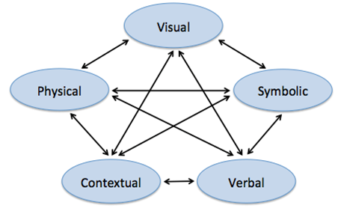
Use and Connect
Mathematical Representations
Different Representations should:
Be introduced, discussed, and connected;
Focus students’ attention on the structure or essential features of mathematical ideas; and
Support students’ ability to justify and explain their reasoning.
Strengthening the ability to move between and among these representations improves the growth of children’s concepts.
Lesh, Post, Behr, 1987

Slide 54

Lens for Watching the Video
Clip 2
In the second video clip Mr. Ziegler visits Groups 1 and 2 for a second time.
Considering the teacher’s actions and interactions with Groups 1 and 2 in both clips, identify what the teacher does to support his student’s productive struggle.
Notes:
HANDOUT 8-TanscriptClip2-HS-Ziegler
See accompanying notes (2. Ziegler Analysis Notes) to support the discussion of the teacher’s actions and interaction.

Slide 55
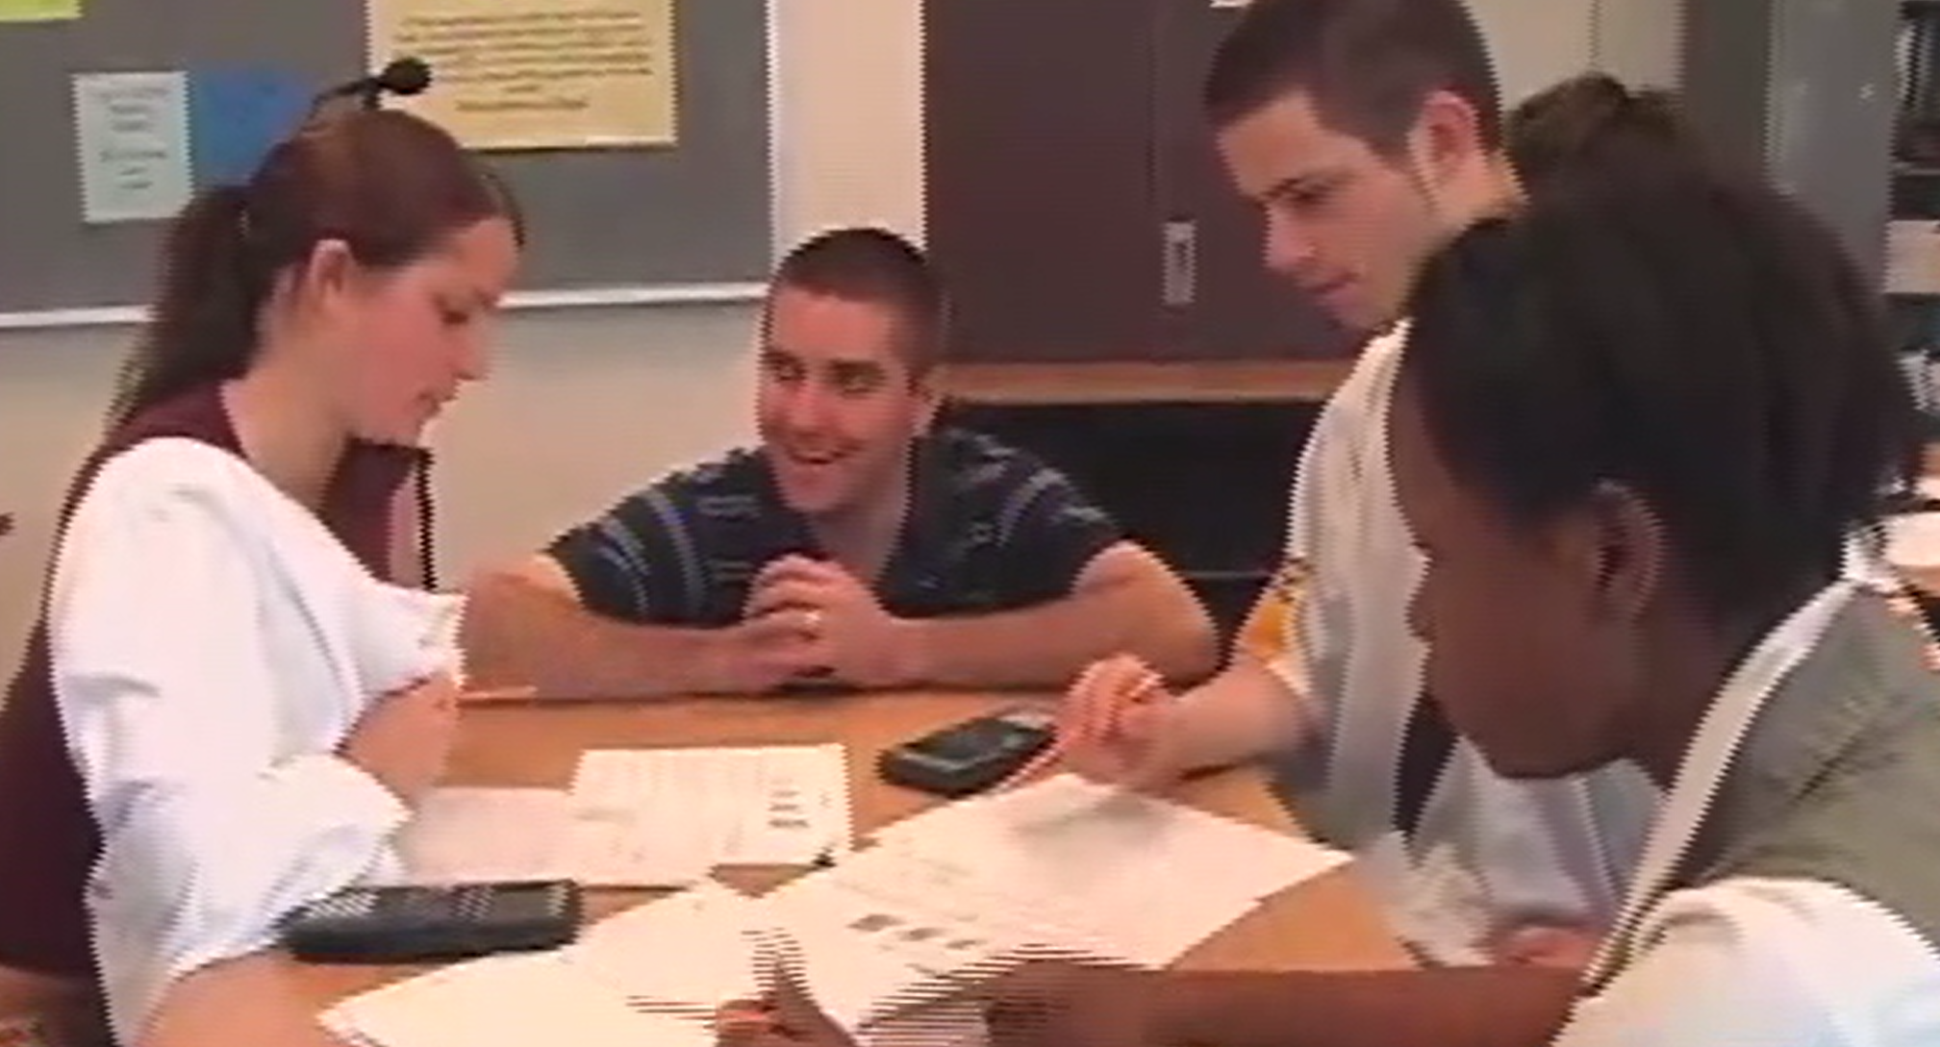
Video Clip 2
http://www.nctm.org/Conferences-and-Professional-Development/Principles-to-Actions-Toolkit/
The-Case-of-Jeffrey-Ziegler-and-the-S-Pattern-Task/

Slide 56
Lens for Watching the Video
Clip 2
In the second video clip Mr. Ziegler visits Groups 1 and 2 for a second time.
Considering the teacher’s actions and interactions with Groups 1 and 2 in both clips, identify what the teacher does to support his student’s productive struggle.
Notes:
HANDOUT 8-TanscriptClip2-HS-Ziegler
See accompanying notes (2. Ziegler Analysis Notes) to support the discussion of the teacher’s actions and interaction.

Slide 57
Effective
Mathematics Teaching Practices
Establish mathematics goals to focus learning.
Implement tasks that promote reasoning and problem solving.
Use and connect mathematical representations.
Facilitate meaningful mathematical discourse.
Pose purposeful questions.
Build procedural fluency from conceptual understanding.
Support productive struggle in learning mathematics.
Elicit and use evidence of student thinking.
Notes:
(This slide is animated. It provides a way of pulling together the ideas that are likely to surface in the discussion.)
Productive struggle can’t happen in isolation from the other practices. In these clips there is direct evidence of practices 2, 3, 5, and 8. Practice 1 can be inferred because we know what he goals were (see slide 5) and his questioning is clearly in service of the stated goals.
There is limited evidence of meaningful discourse here because of the nature of the clips -- we only can see what the groups are doing when the teachers is with them -- and we do not have access to what they did on their own or to the whole group discussion that took place later in the lesson.

Slide 58
Planning with the Student in Mind
Anticipate solutions, thoughts, and responses that students might develop as they struggle with the problem
Generate questions that could be asked to promote student thinking during the lesson, and consider the kinds of guidance that could be given to students who showed one or another types of misconception in their thinking
Determine how to end the lesson so as to advance students’ understanding
  Stigler & Hiebert, 1997

Slide 59
Effective
Mathematics Teaching Practices
Establish mathematics goals to focus learning.
Implement tasks that promote reasoning and problem solving.
Use and connect mathematical representations.
Facilitate meaningful mathematical discourse.
Pose purposeful questions.
Build procedural fluency from conceptual understanding.
Support productive struggle in learning mathematics.
Elicit and use evidence of student thinking.

Slide 60
Reflection
What lessons can we learn from these classroom implementations?
What implications do they have for your work?
Notes:
The slides that follow provide some possible “lessons” that could be learned from these two implementations.

Slide 61
Principles to Actions Resources
Principles to Actions Executive Summary
(in English and Spanish)
Principles to Actions overview presentation
Principles to Actions professional development guide (Reflection Guide)
Mathematics Teaching Practices presentations
  Elementary case, multiplication (Mr. Harris)
  Middle school case, proportional reasoning (Mr. Donnelly) (in English and Spanish)
  High school case, exponential functions (Ms. Culver)
Principles to Actions Spanish translation

Slide 62
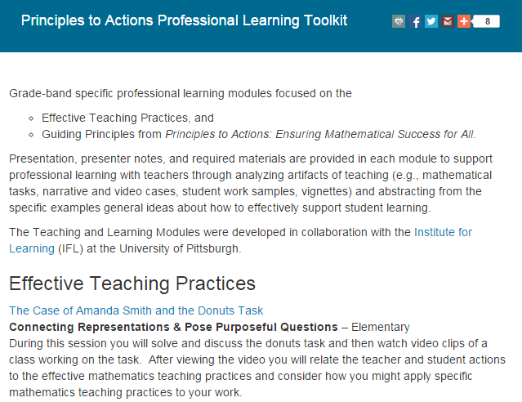
http://www.nctm.org/PtAToolkit/

Slide 63
Thank You!
Diane Briars
dbriars@nctm.org
nctm.org/briars

